Slide 1

Mad Dash
A Hide and Seek Game
By Jesica Ababon

Slide 2
Mad Dash
Game Description
In Mad Dash, the player must find 5 or 10 key items on the board before time runs out.
This game consists of three levels and was built using HMTL, CSS and JavaScript.
jQuery was used for DOM manipulation.
My goal was to utilize the knowledge we obtained to make a cute game I could eventually evolve over time.
The game displays nicely in both desktop and mobile browsers.
PLAY GAME HERE

Slide 3
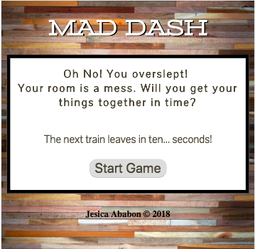
Mad Dash
Landing Page
Includes a brief description of the game and start button.

Slide 4
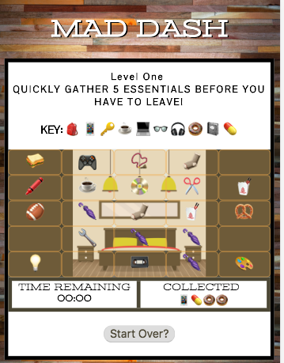
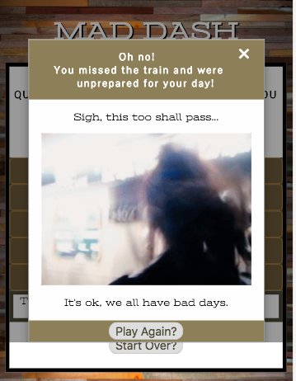
Mad Dash
Levels
The three game levels include the playfield, a timer, and win/lose modals (with gifs and taunting sounds!).

Slide 5
Mad Dash
Future Improvements
Animation for key selection
Themed levels
Improved randomization of items
Improved key item display
Player-chosen field size
Field loading in current window location
Change emoji to images.
Not all emoji supported on Android devices.

